Slide 1
Introduction to Linux Systems Basis of Hardware and Software
Chia-Heng Tu
Dept. of Computer Science and Information Engineering
National Cheng Kung University
Fall 2024
Lab1: Installation of Linux system-based virtual machine software
Courtesy of Ch0, Ch1, and Ch2, 鳥哥的Linux私房菜, 2016

Slide 2
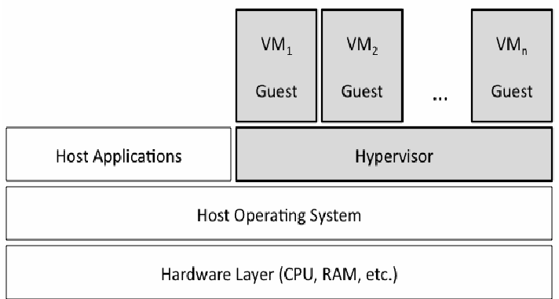
What is vm?

Slide 3
Lab - Installation of Linux system-based virtual machine software
Download Oracle VM VirtualBox (Optional)
Download Ubuntu 22.04 iso (Optional)
Install Ubuntu 22.04 in VirtualBox with disk partition (/: 20GB, /home:25GB,/boot:1GB,/tmp:2.3GB)
Check the partition by $ lsblk

Slide 4
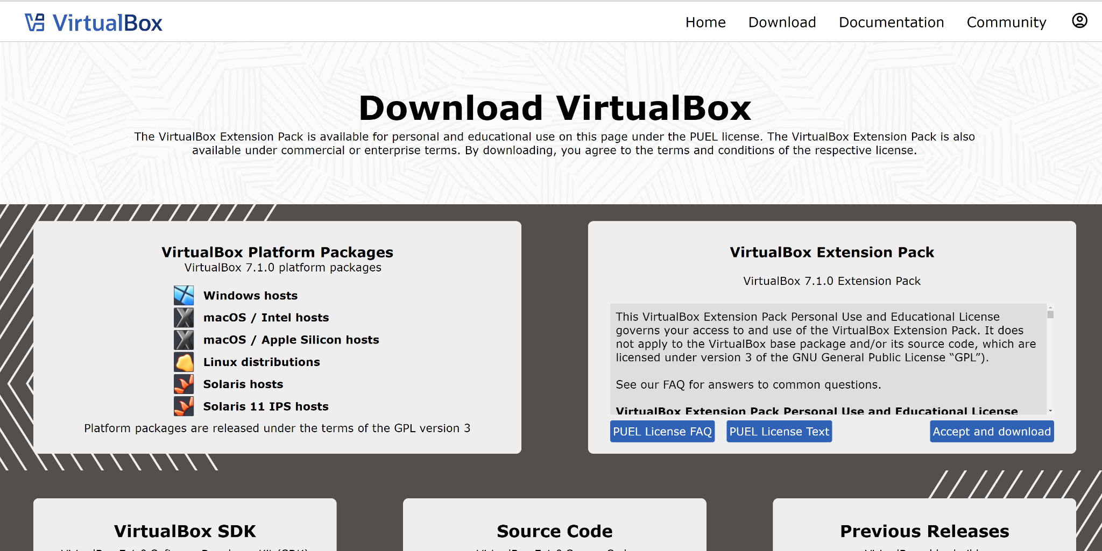
Oracle VM VirtualBox (Optional)

Slide 5
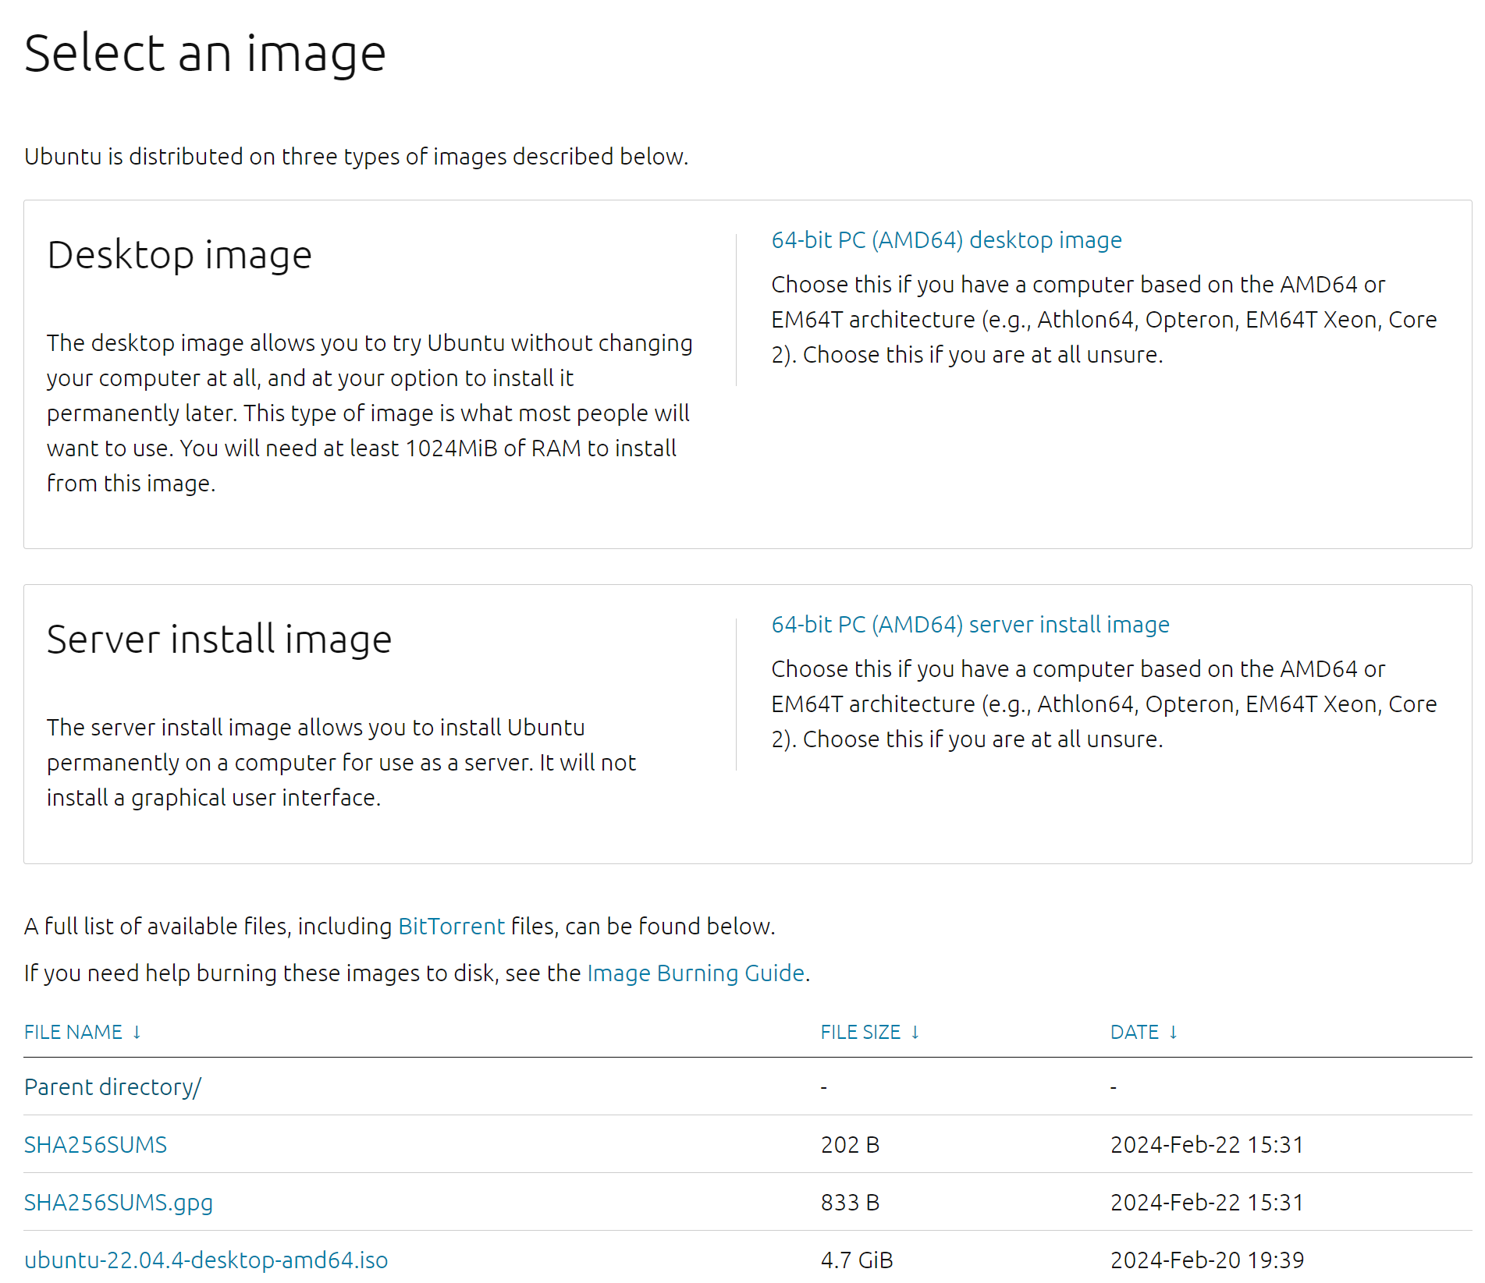
Ubuntu 22.04 (Optional)

Slide 6
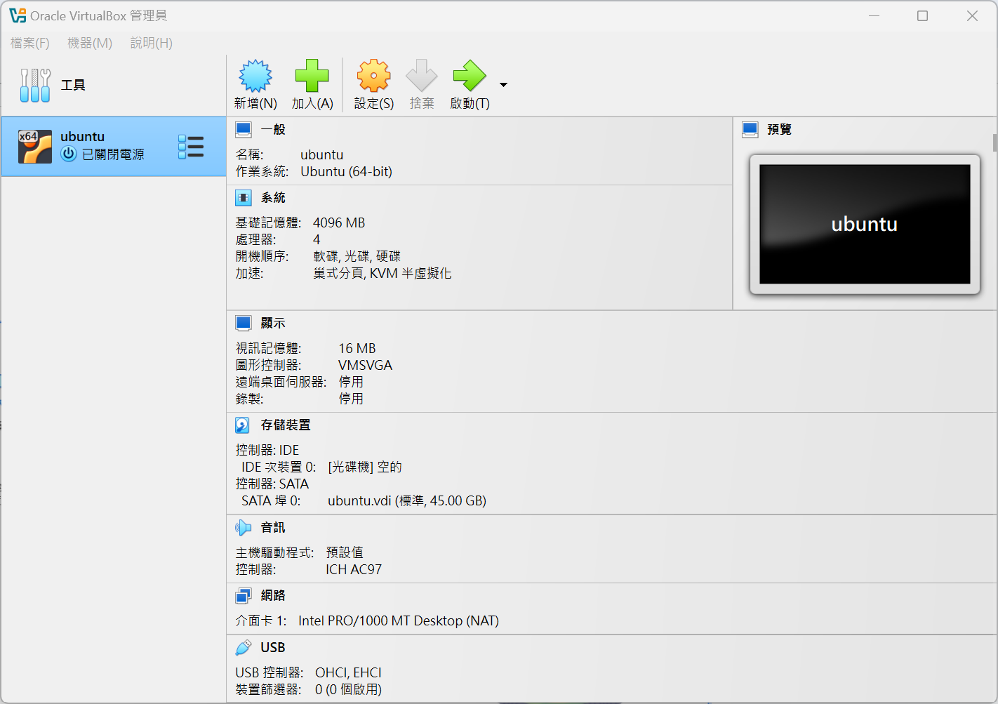

Slide 7
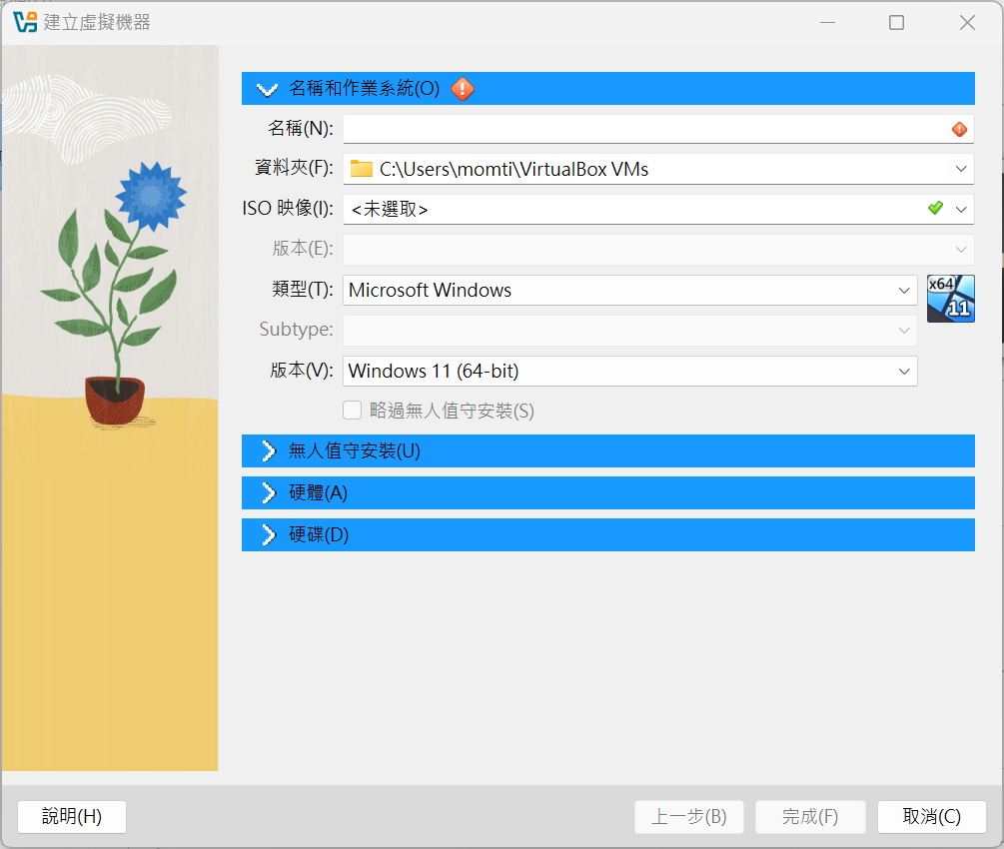

Slide 8


Slide 9
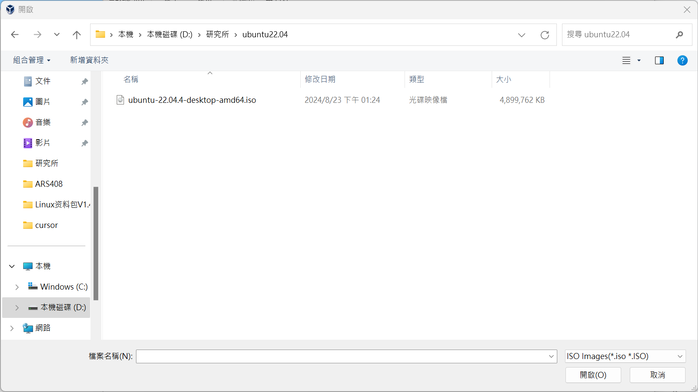
ISO file in USB

Slide 10
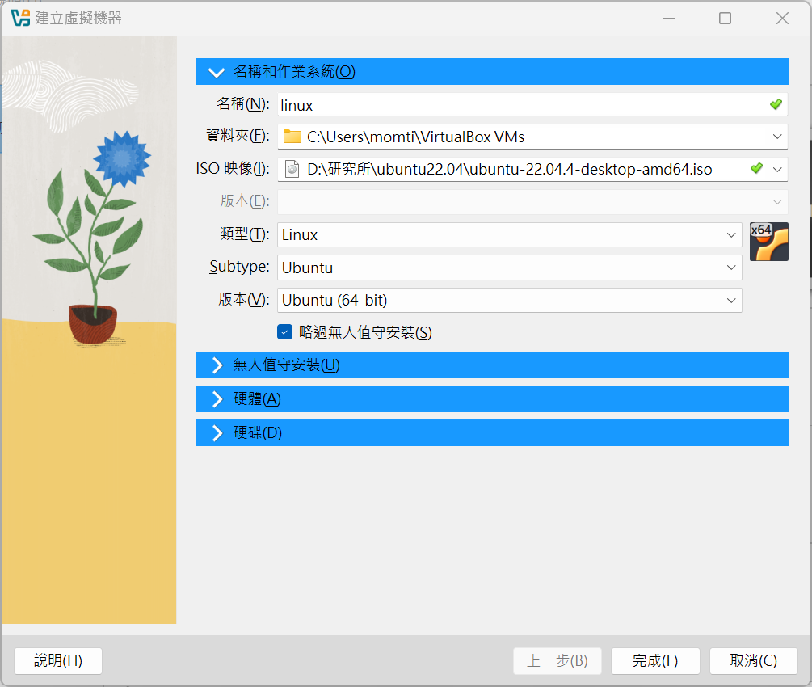

Slide 11
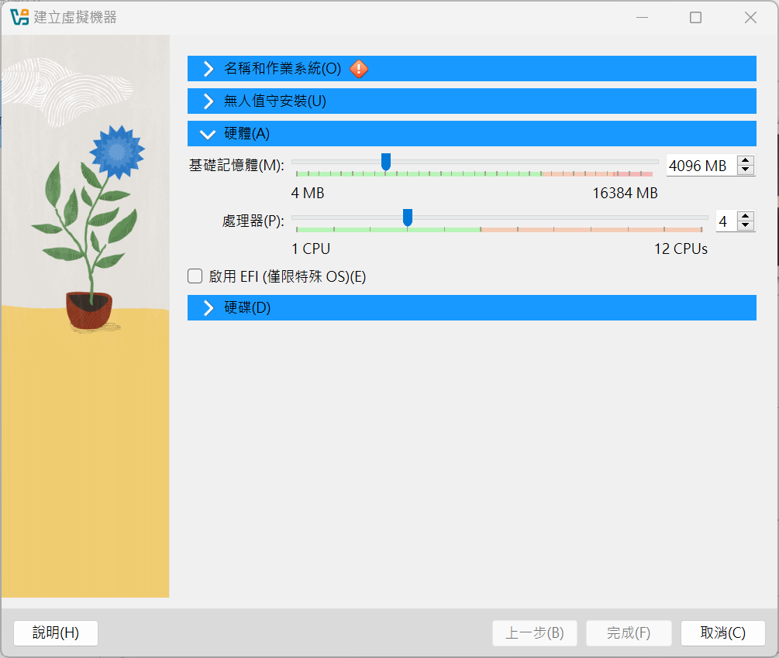

Slide 12
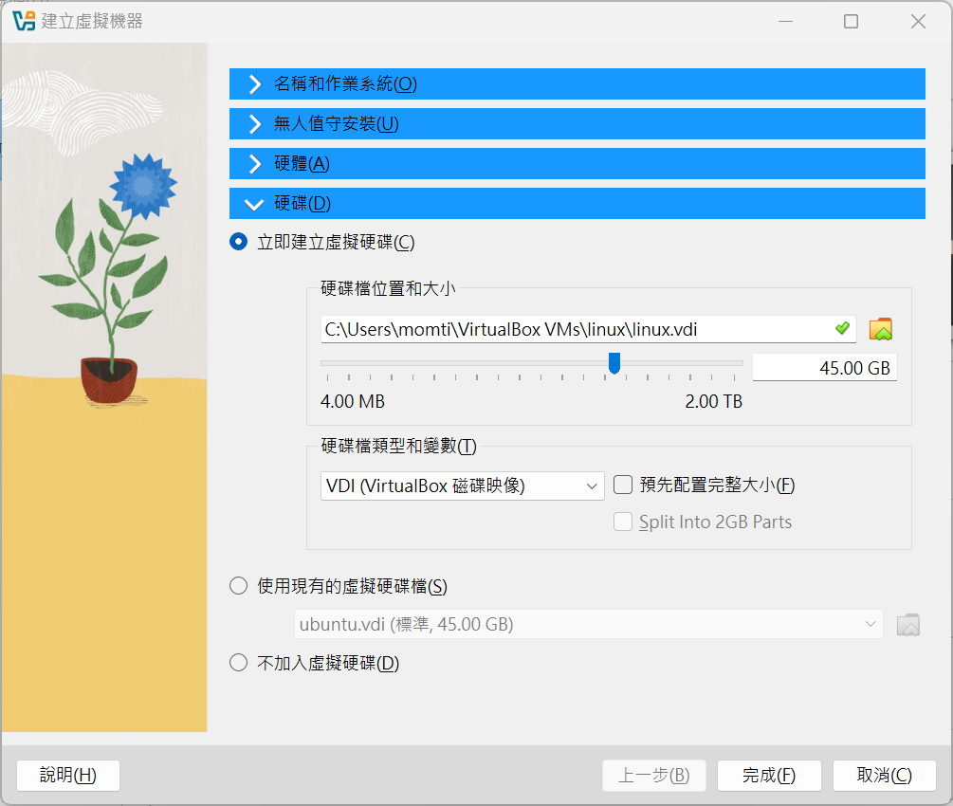

Slide 13
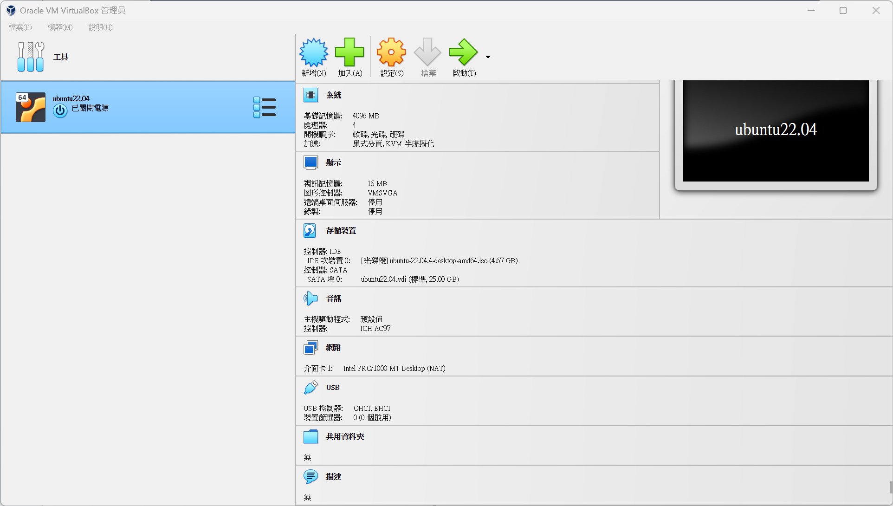

Slide 14
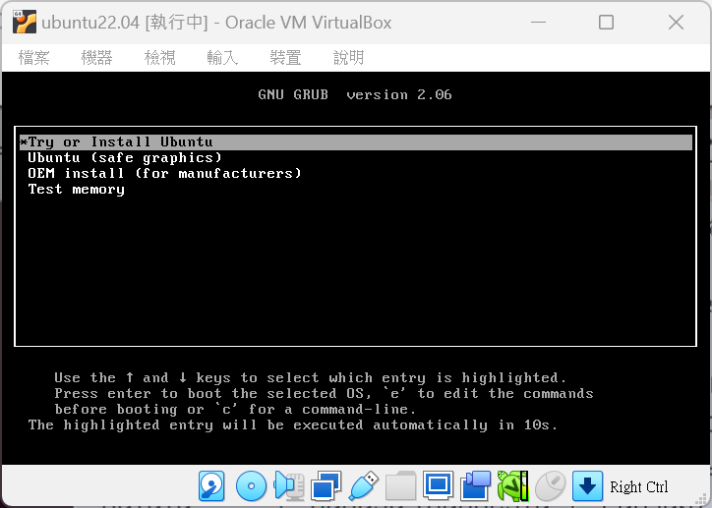
enter

Slide 15
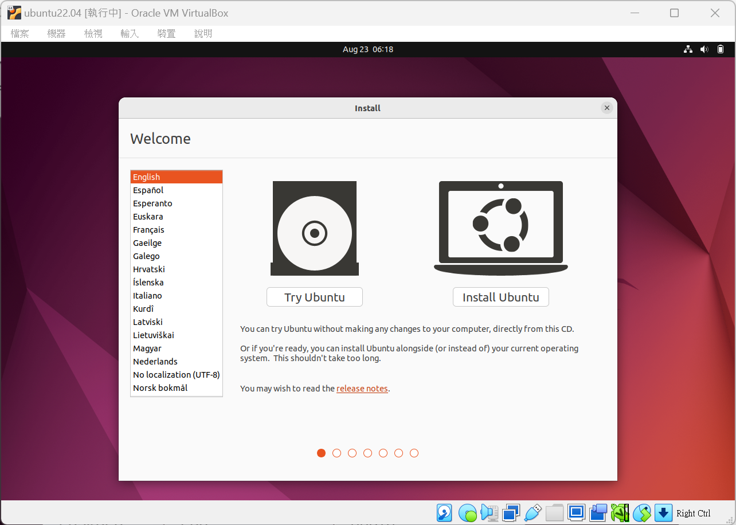

Slide 16
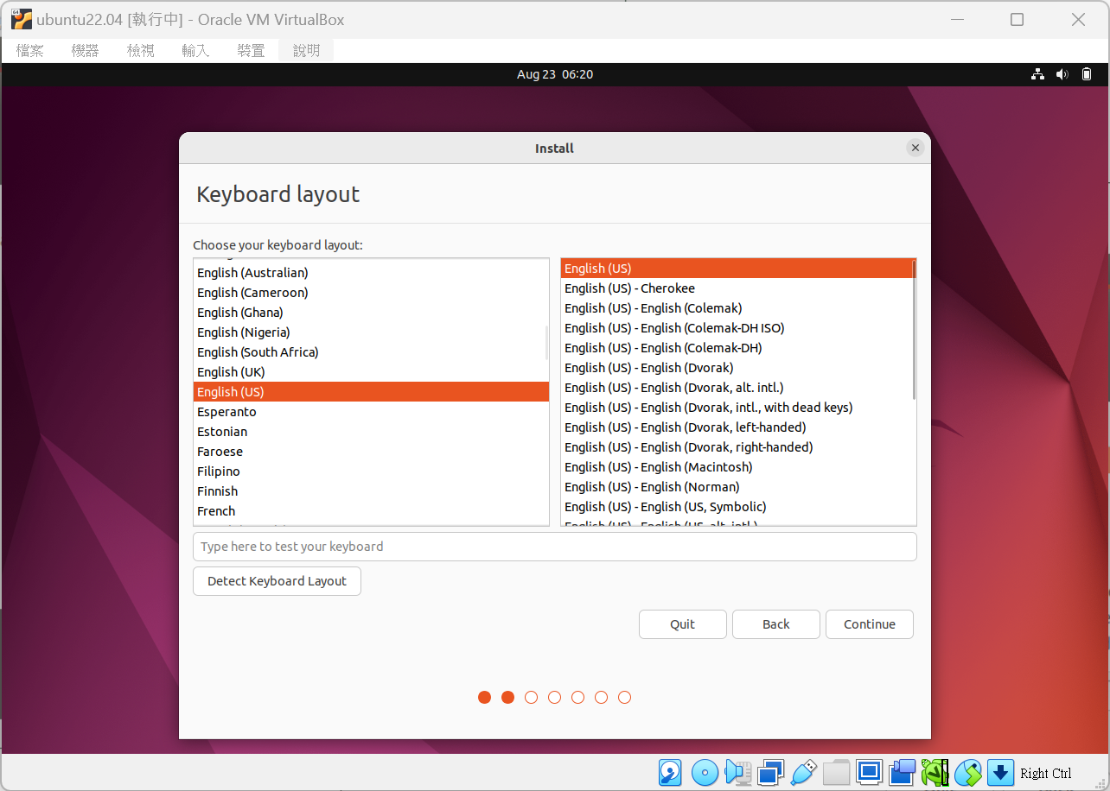

Slide 17
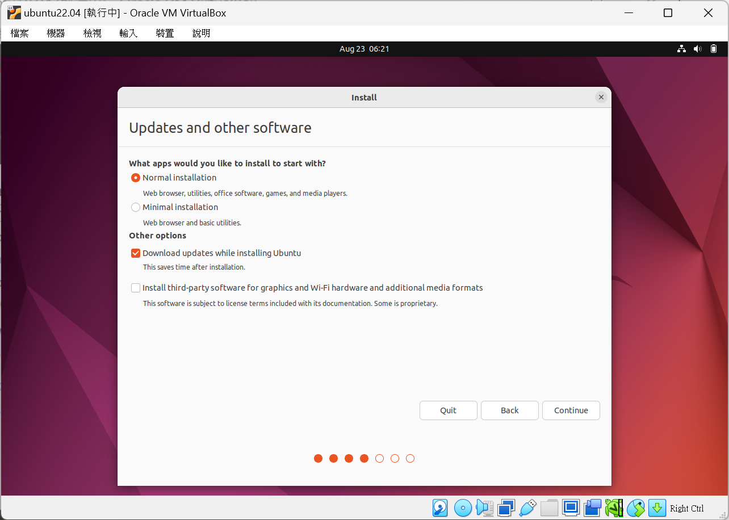

Slide 18
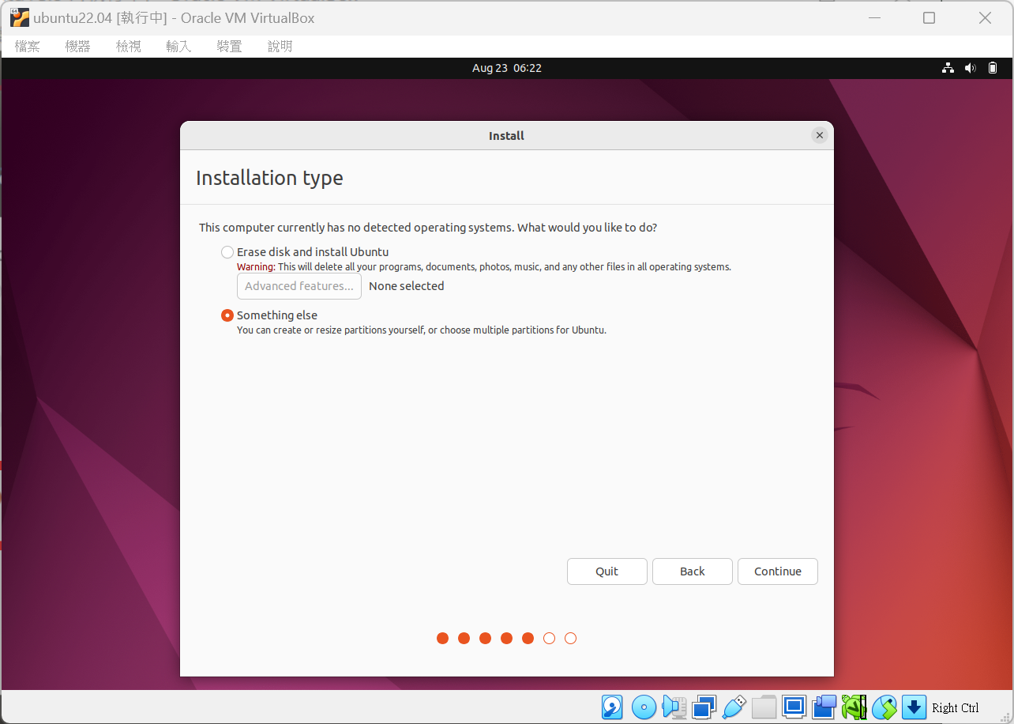

Slide 19
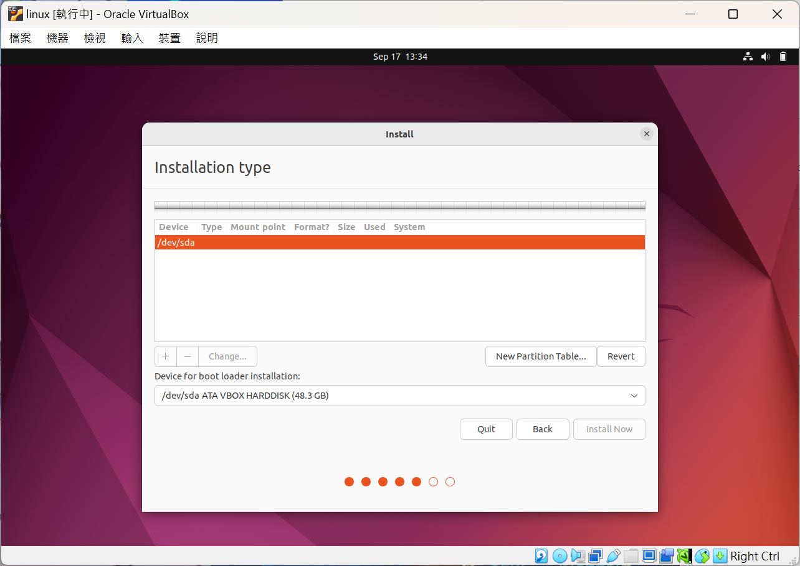
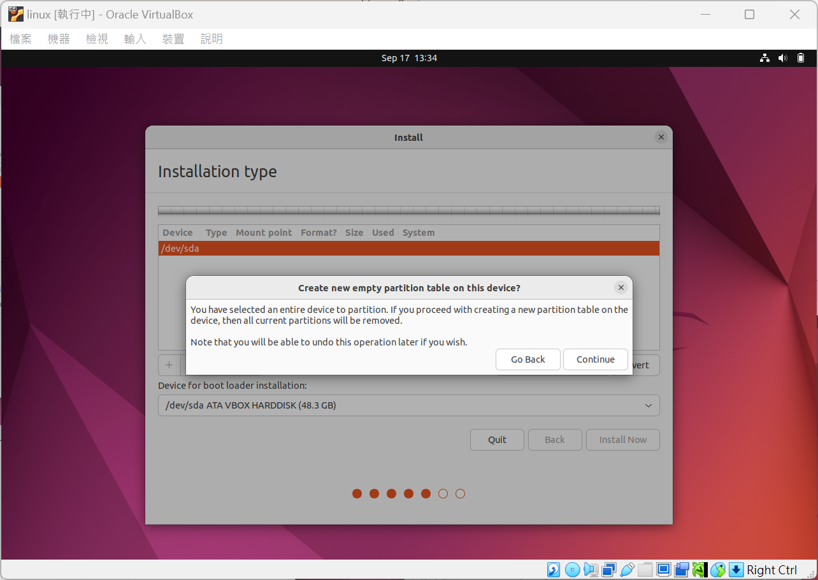

Slide 20
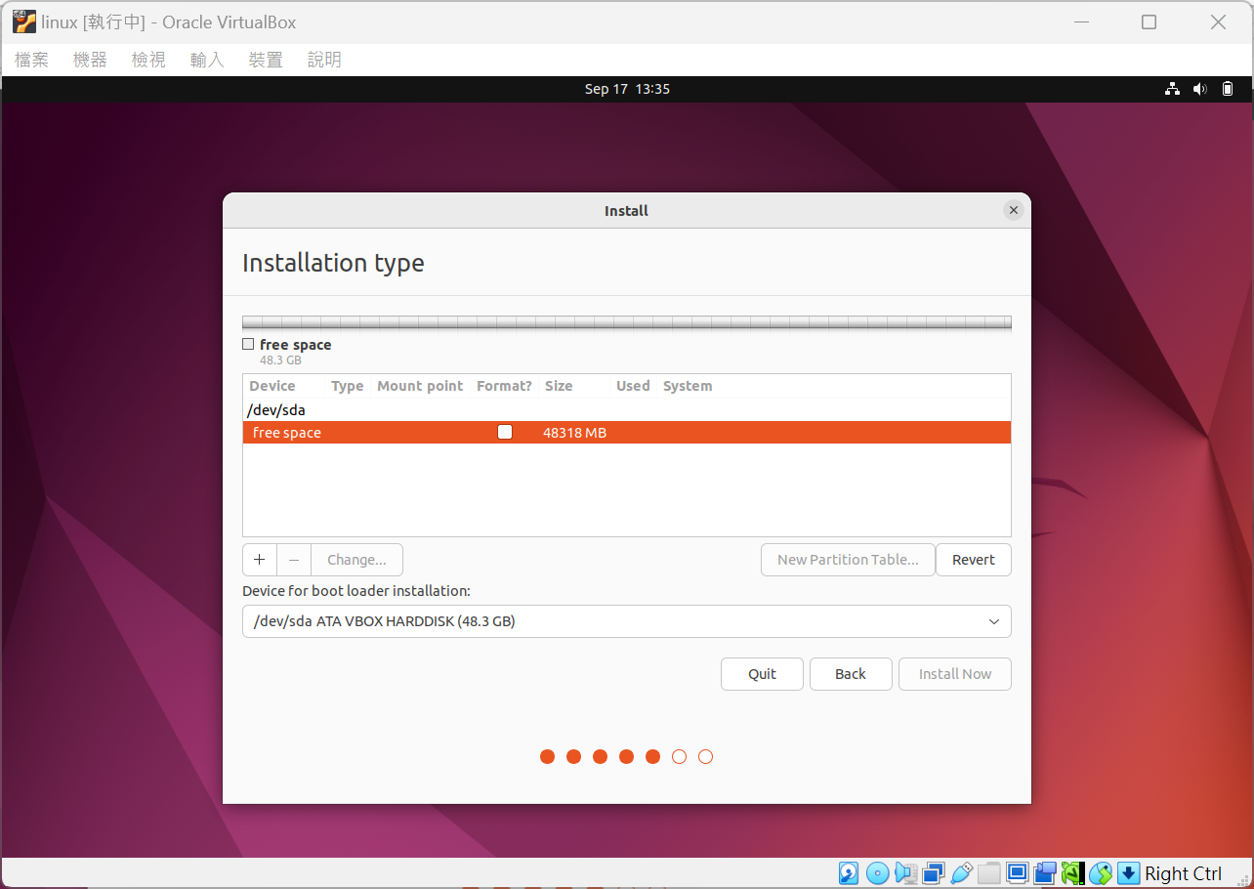

Slide 21
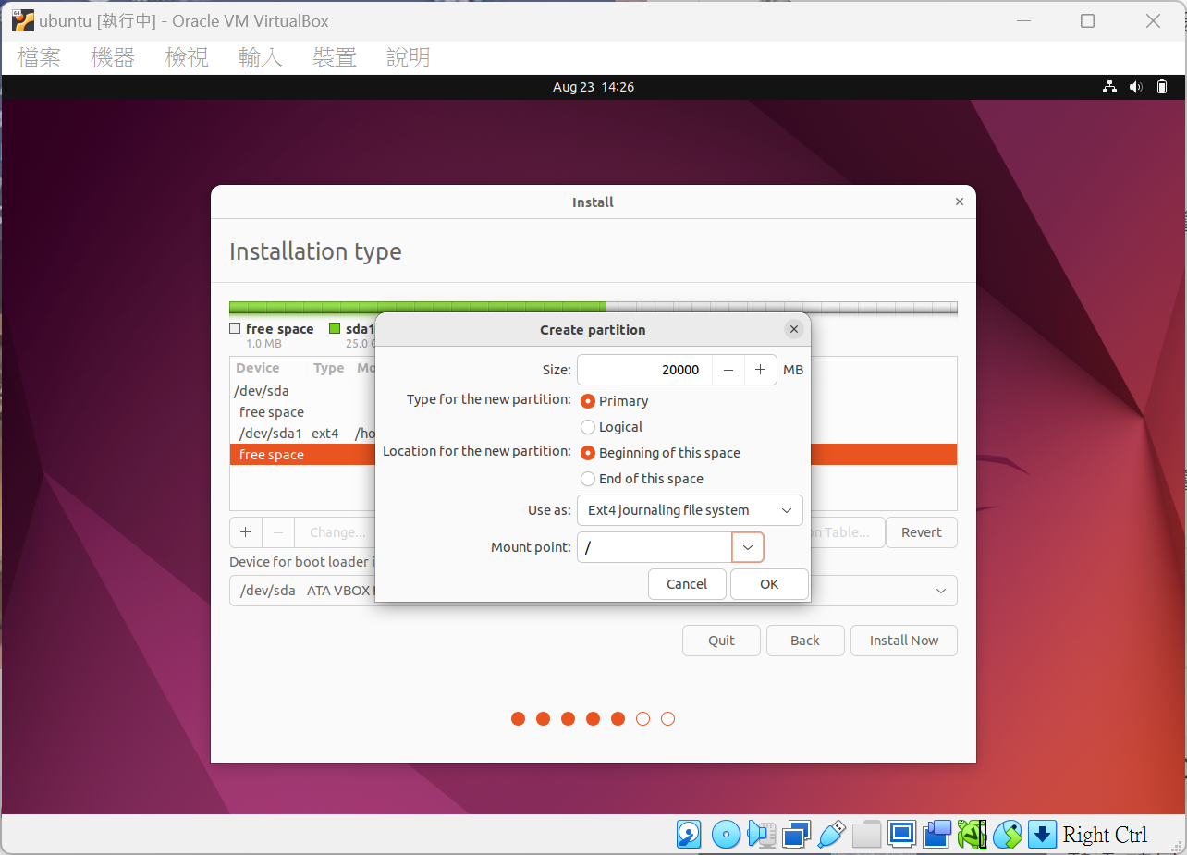
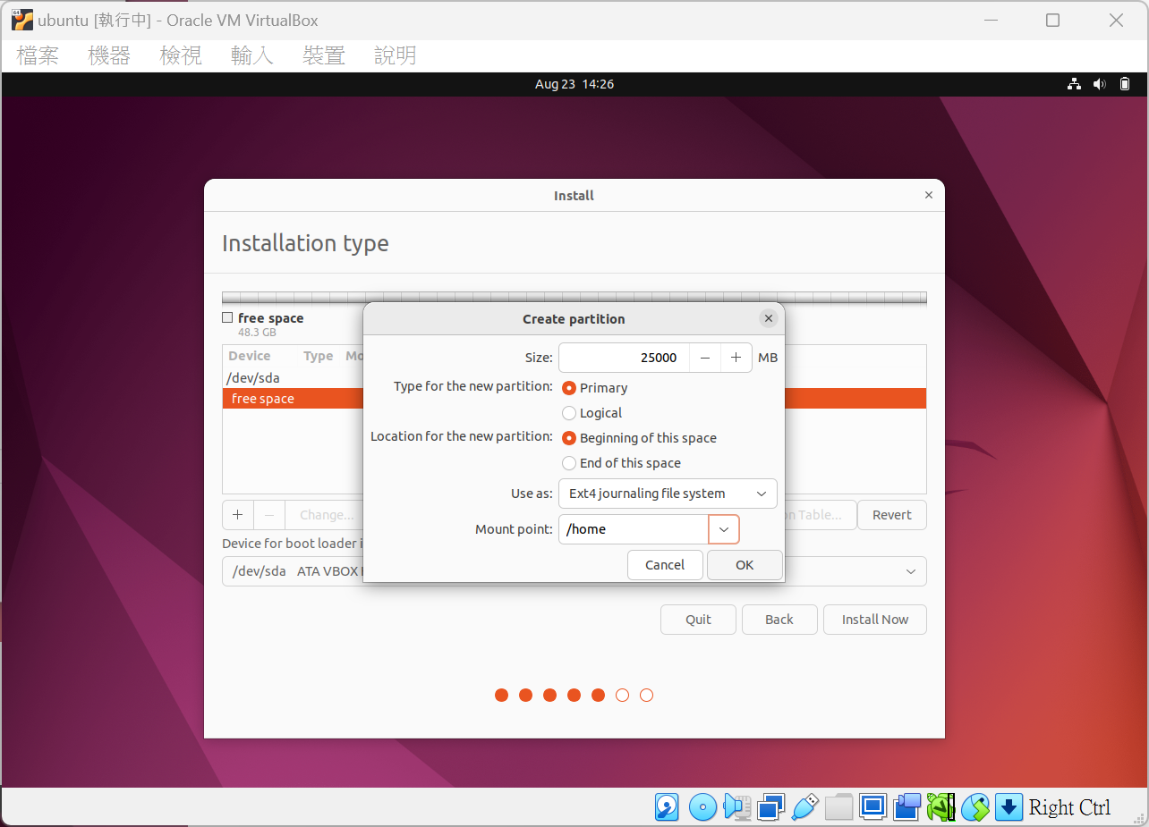

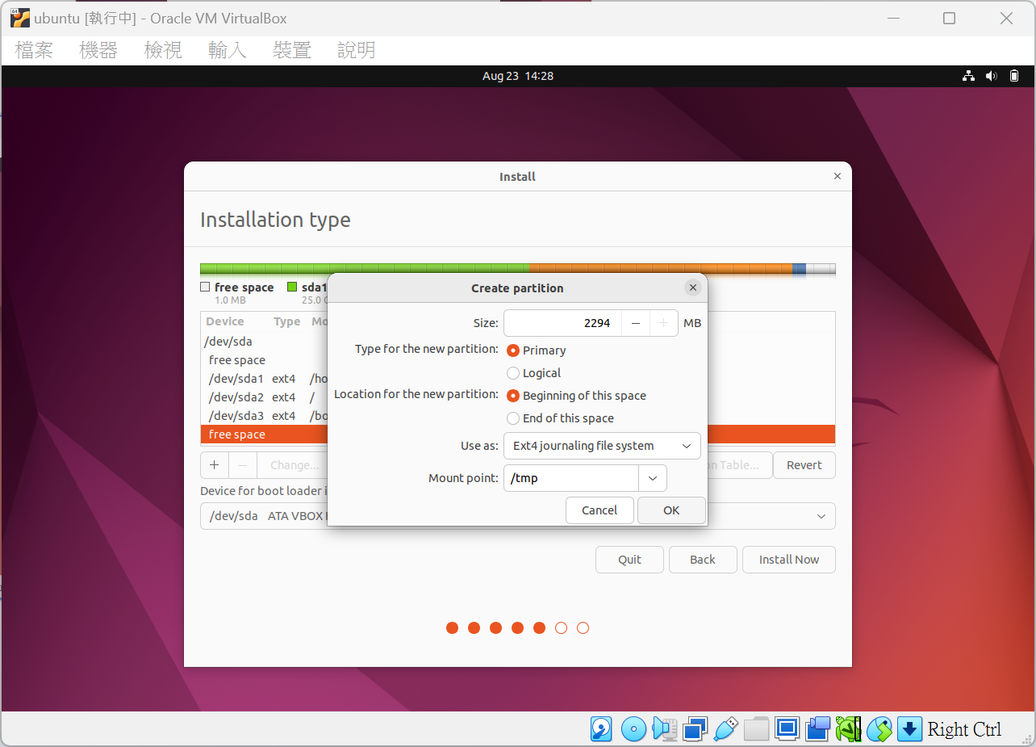

Slide 22
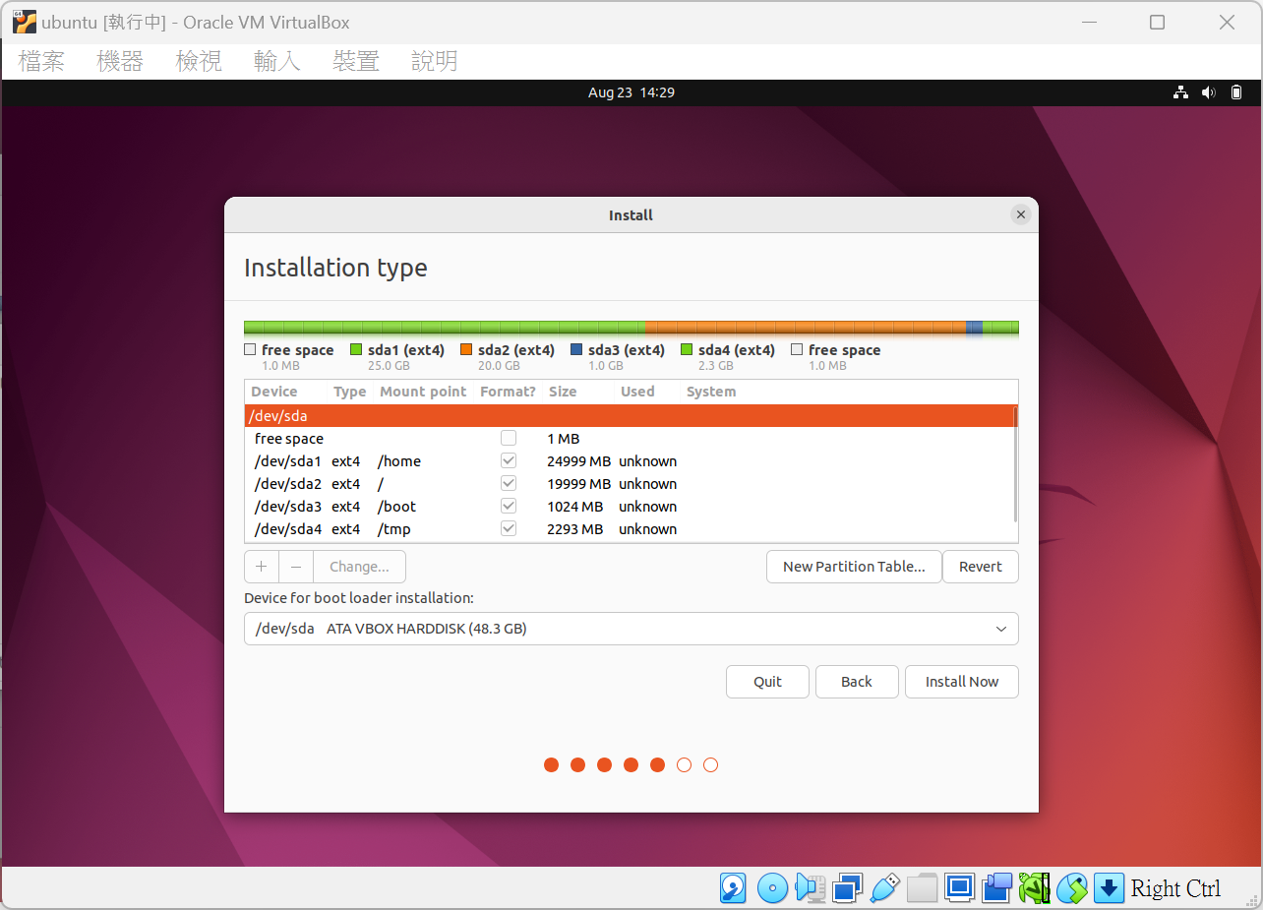

Slide 23
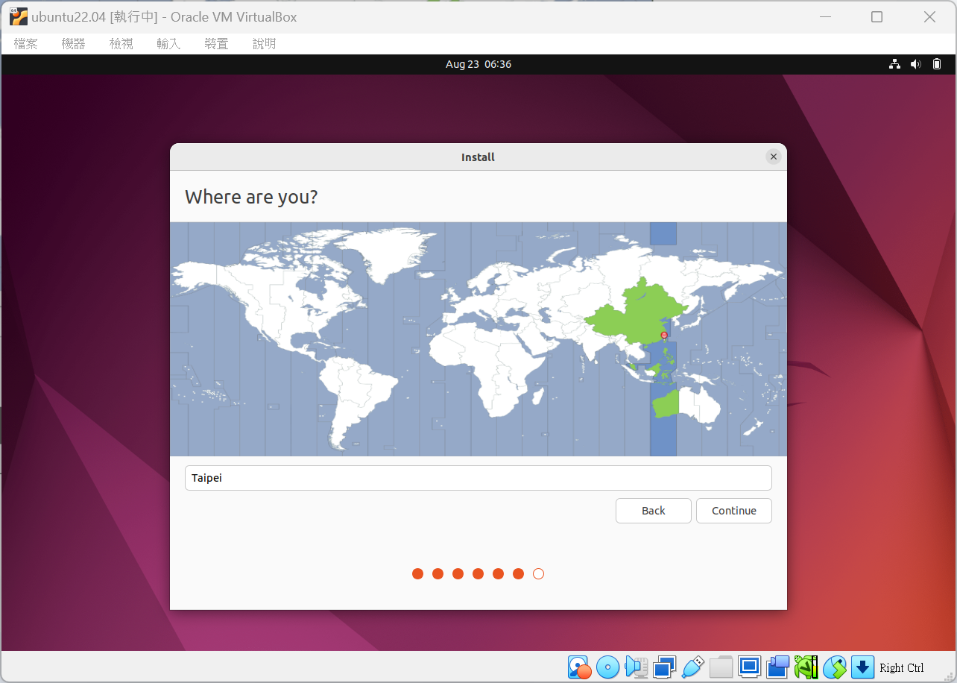

Slide 24
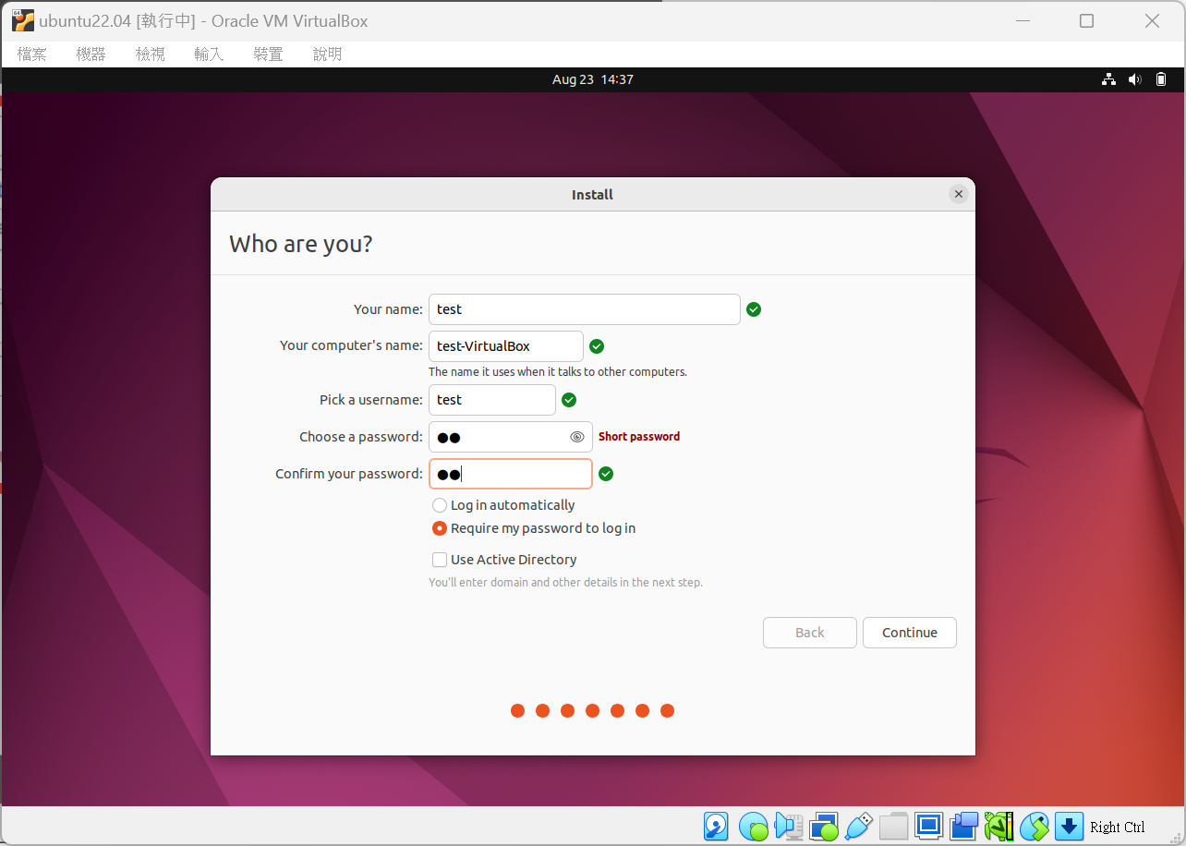

Slide 25
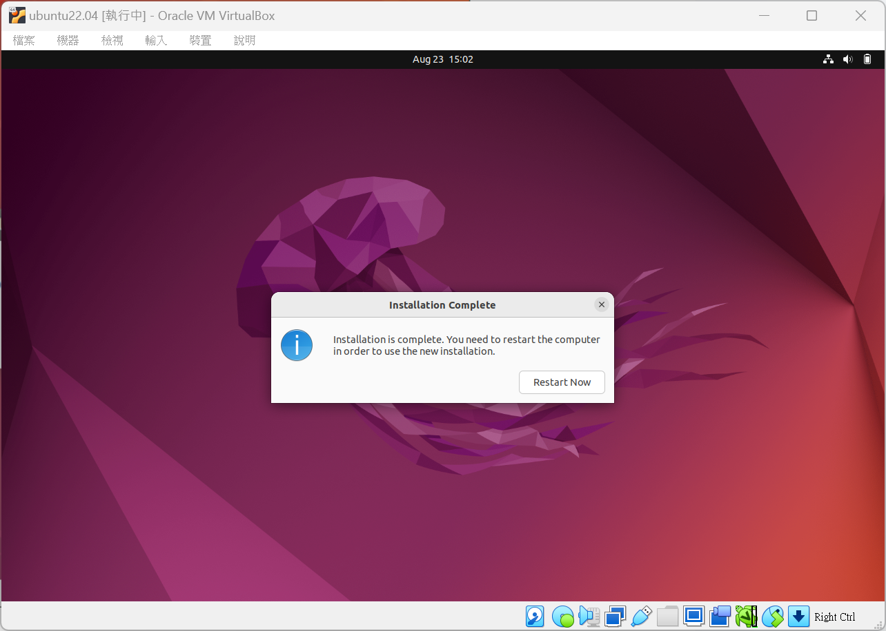

Slide 26
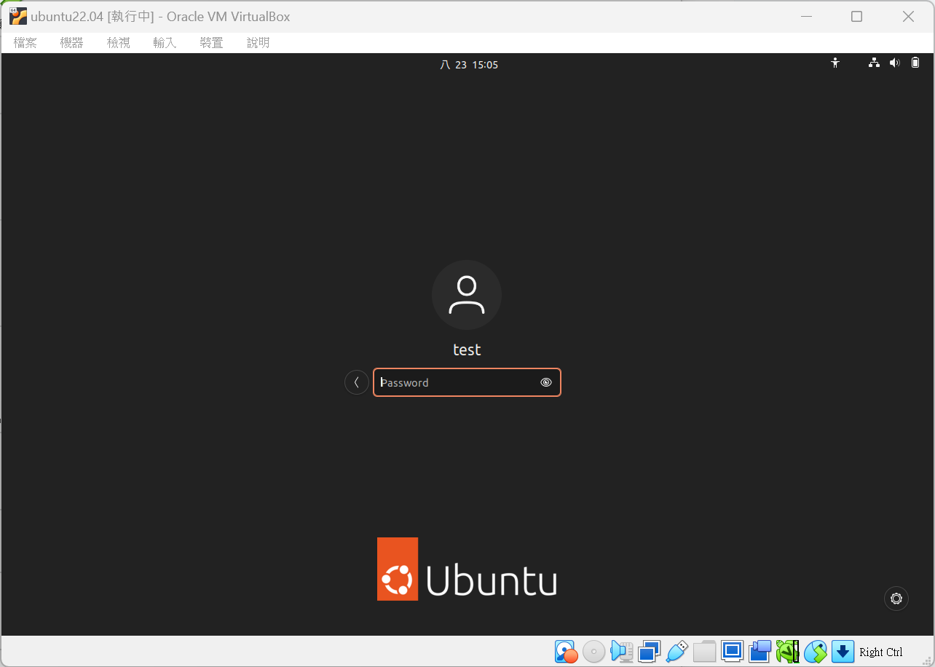

Slide 27
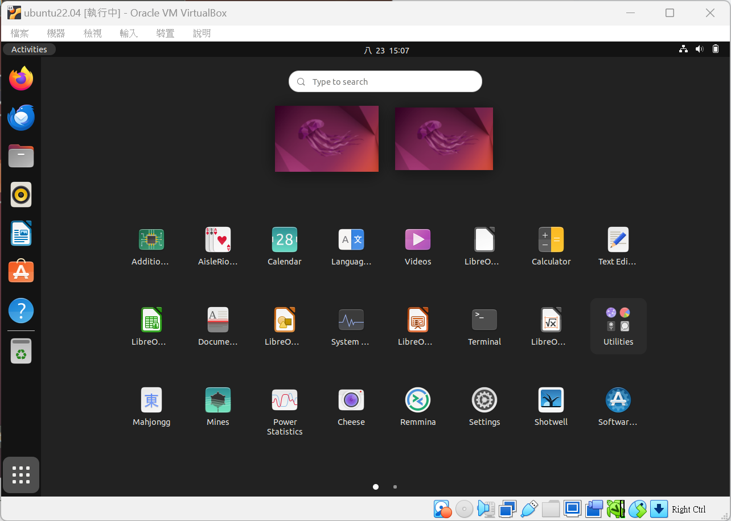

Slide 28
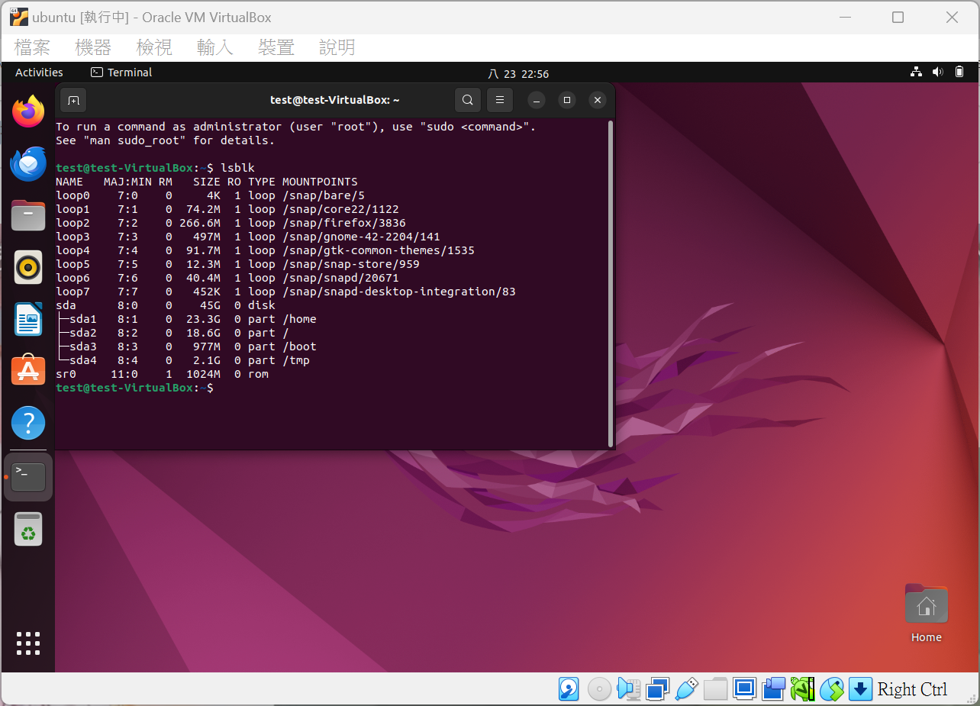

Slide 29
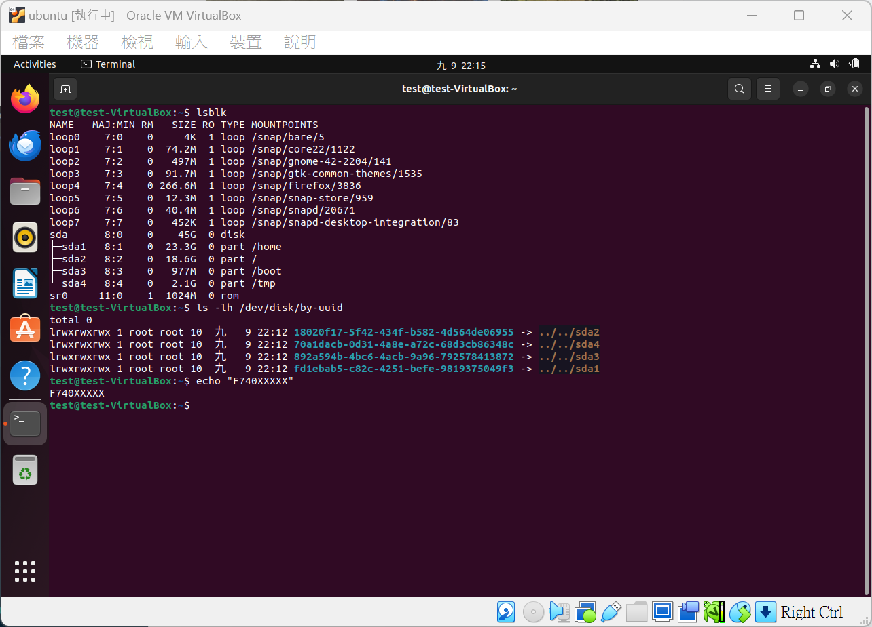
Demo
檢查項目
lsblk 輸出 (至少3個分割)
uuid 輸出
echo 自己的學號
繳交方式：截圖上傳至 moodle，須包含以上三樣檢查項目
僅供參考

Slide 30
QUESTIONS

